Slide 1
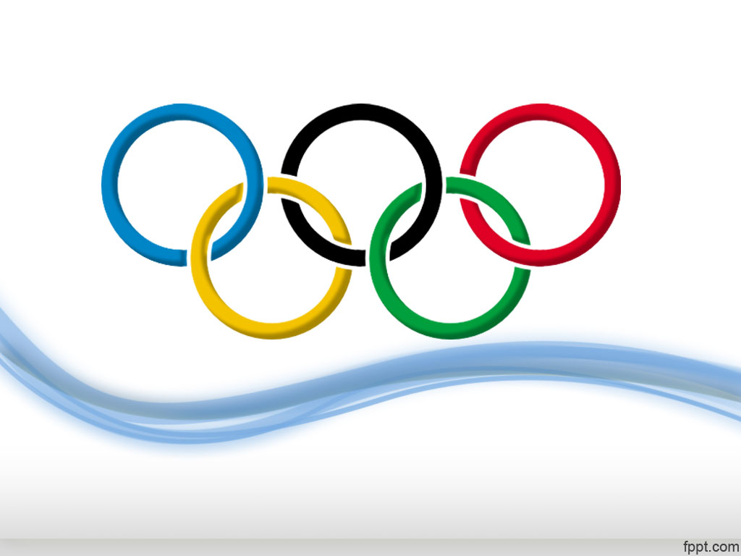
Women Olympic Athletes
Beth Myers
Kurt Dietrich

Slide 2
Purpose: Find Prominent
Women Olympic Athletes
Representing which country?
Which games?
  Summer or Winter?
  When and where?
  In how many games did they participate?
Which events?
  Which sport(s)?
  How many events and medals

Slide 3
Finding Data
Kaggle
Wikipedia

Slide 4
Data Cleanup & Analysis
Source Data
  Extracted and Scaped 3 Tables
    Athlete_events [Kaggle.com]
    Noc_regions [Kaggle.com]
    Host_cities [https://en.wikipedia.org/wiki/List_of_Olympic_Games_host_cities]

Slide 5
Data Cleanup & Analysis
  Web scraping
    Table from Wikipedia
    Dropped 3 columns
  Adjusted 2 .csv tables from Kaggle
    Region table required little work other than renaming columns
    Split Athlete_events table into 6 tables for design of relational datebase
    Removed duplicates
  All columns renamed for SQL DB format

Slide 6
Data Cleanup & Analysis
Final Data
  Constructed tables in pgAmin (via queries in VSCode)
  Cleaned data and created dataframes
  Data Pushed via Pandas SQLAlchemy
  Tested data by running SELECT * queries

Slide 7
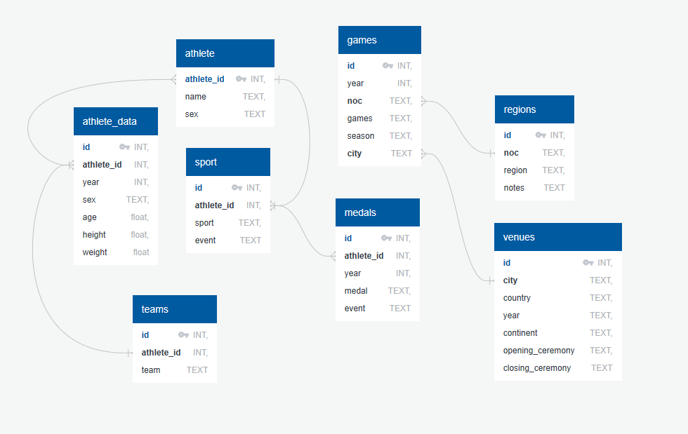
Data Cleanup & Analysis
Schema (quickdatabasedesign.com)

Slide 8
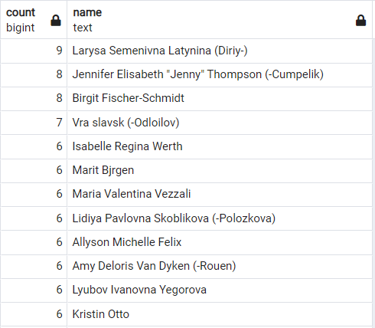
Quick Data Analysis
Query 1:
Top 12 Women with the most Gold medals

Slide 9
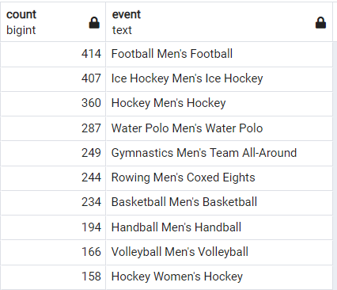
Quick Data Analysis
Query 2:
Top Sports with the most Gold medals, in aggregate

